Slide 1
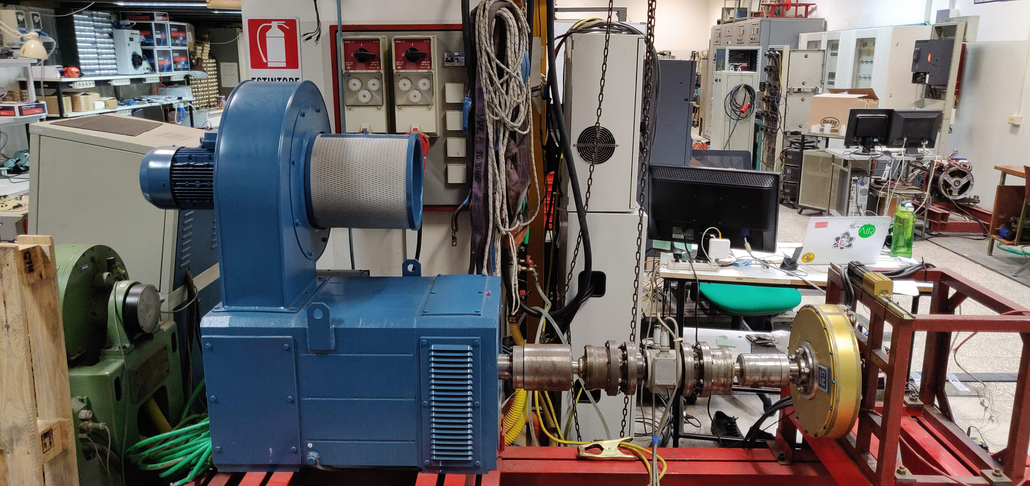
Development of a LabVIEW Based Measurement and Control System for an Electric Vehicle Powertrain Test Bench
Arda Hatunoglu
Faculty of Engineering
Laurea Magistrale in Renewable Energy Engineering
Advisor: Prof. Giulio De Donato
Co-Advisor: Mr. Federico Marcolini
Notes:
Hello everyone, I am «ARDA HATUNOGLU» and today I am going to present my thesis. The title of the research is «Development of a LabVIEW Based Measurement and Control System for an Electric Vehicle Powertrain Test Bench». My advisor is Professor Giulio De Donato which I took immense amount of help and guidance. Let’s dive in to it!

Slide 2

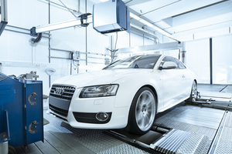
Problem?
Emulate standardized test cycles for electric vehicles with a in-house made LabVIEW software.
Notes:
The problem I tried to tackle is to emulate standardized worldwide known test cycles for electric vehicles with a in-house made LabVIEW software. The reason why LabVIEW is preferred instead of Simulink is the
Ease of connection to different instruments while in simulink the ability interface with other laboratory instruments is more difficult.
As you can see, normally standardized driving cycles are being run on standardized and calibrated dynamometers under laboratory conditions and approved by an accredited "Technical Service". The advantage: The results of the tests are comparable and reproducible across all manufacturers and dynamometers.
In order to emulate this process, one drive would be acting like the resistive forces in a vehicle which would be in torque control mode and the second drive which in golden color on the right side would act like the drive motor in a car which will be setting the rotational speed of the shaft which corresponds to the kilometer per value in a real vehicle.

Slide 3
Objectives
To be able study electric vehicle powertrains in a laboratory environment
to have a LabVIEW software that is more capable then the proprietary software of VFD producers
to be able to conduct common vehicle tests like WLTP;
to develop a computer model for the brake motor which represents the vehicle and road conditions
to be able to control the speed and torque of the different drives through LabVIEW manually
Notes:
After defining the problem, the objectives has be set and defined.
To be able study electric vehicle powertrains in a laboratory environment instead of having need to have a real vehicle and a dynamometer.
to have a LabVIEW software that is more capable then the proprietary software of VFD producers
to be able to conduct common vehicle tests like WLTP;
to develop a computer model for the brake motor which represents the vehicle parameters and road conditions;
to be able to control the speed and torque of the different drives through LabVIEW

Slide 4
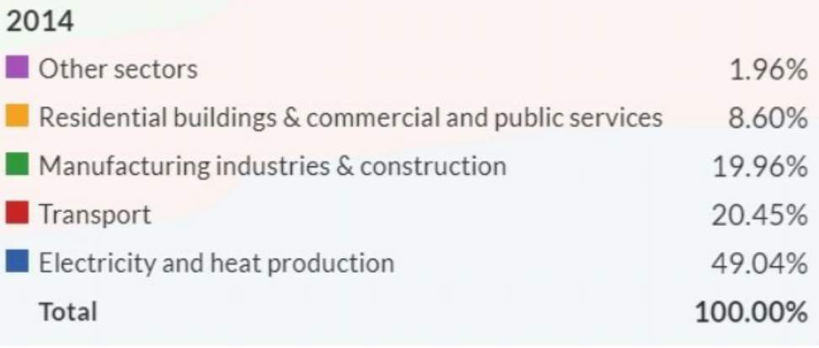
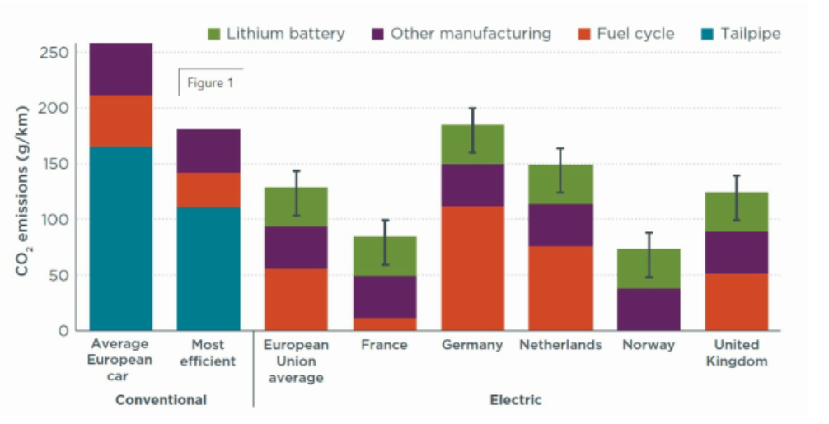
Introduction
Vehicle electrification to tackle climate change
Transportation sector %20.45 in 2014
Life-cycle emissions of a vehicle comparison
Notes:
Vehicle electriﬁcation is considered to be one of the most promising approach
toward addressing the concerns on climate change, sustainability, and rapid depletion
of fossil fuel sources.. Top right figure it can be seen that transportation is responsible for %20.45 of the CO2 emissions in the world.
Life-cycle emissions (over 150000km) of electric and conventional vehicles in Europe in 2015.
EXPLAIN THE GRAPH
The only thing that is missing in the life cycle missing is CO2 emissions during disposal of the vehicle and material extraction.

Slide 5
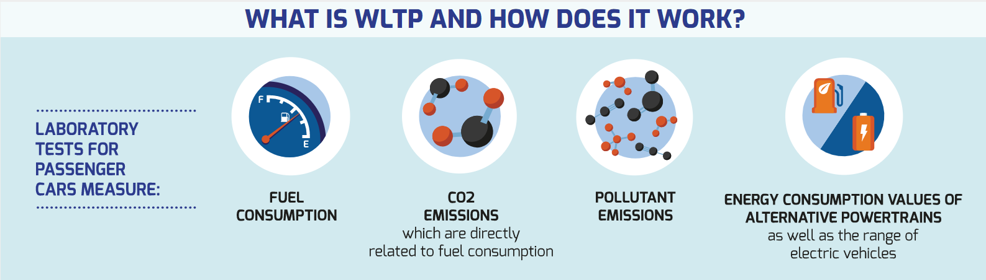
Worldwide Harmonised Light Vehicle Test Procedure
Notes:
WLTP was developed with the aim of being used as a global test cycle across different world regions, so pollutant and CO2 emissions as well as fuel consumption values would be comparable worldwide. However, while the WLTP has a common global ‘core’, the European Union and other regions will or can apply the test in different ways depending on their road traffic laws and needs. What is measured in this test is the fuel consumption and the emissions as well as, in the case of hybrid and electric vehicles, the electric range.

Slide 6
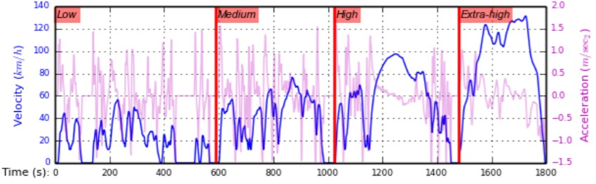
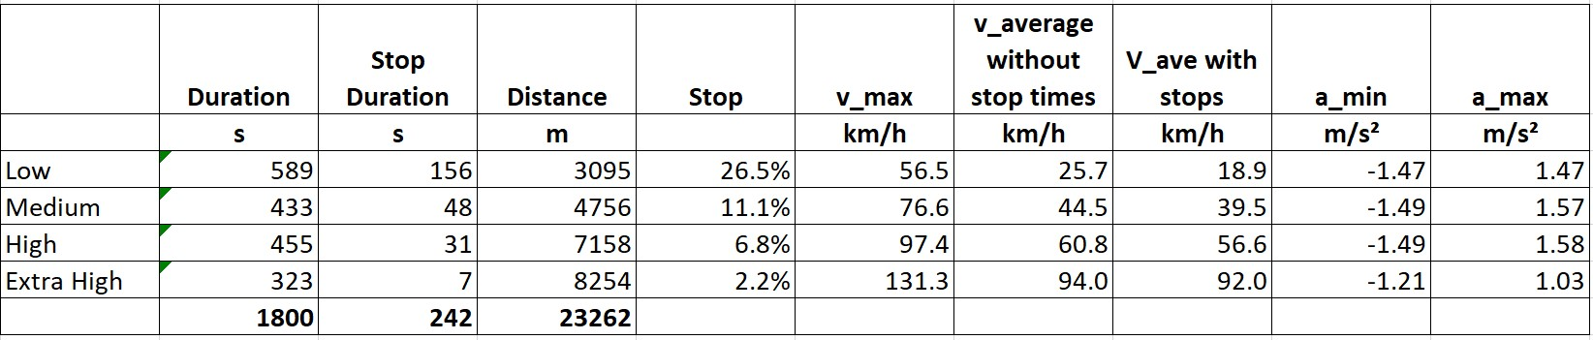
Worldwide Harmonised Light Vehicle Test Procedure
Notes:
For a certain car type, each powertrain configuration is tested with WLTP for the car’s lightest (which is the most economical) and heaviest (which is the least economical) version.
The WLTP driving cycle is divided into four parts with different average speeds: low, medium, high and extra high. Each part contains a variety of driving phases, stops, acceleration and braking phases. Total duration of the test is 30 minutes where 23km distance is covered with different maximum speeds in different sections. As can be seen from the table the maximum velocity values for low,medium, high, extra-high are about 57, 77, 97, 131 kilometers per hour.

Slide 7
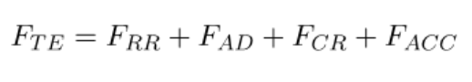
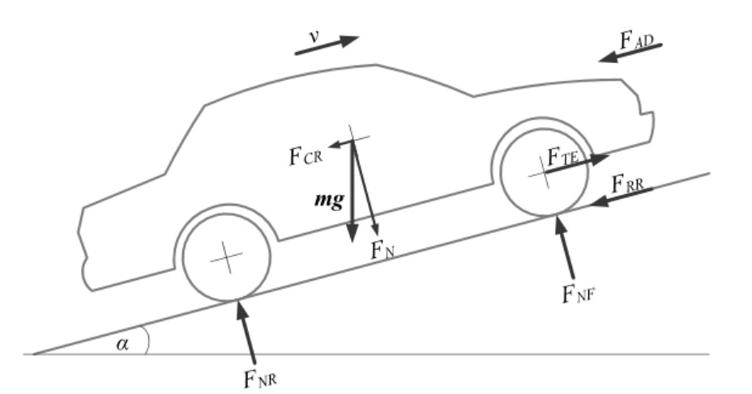
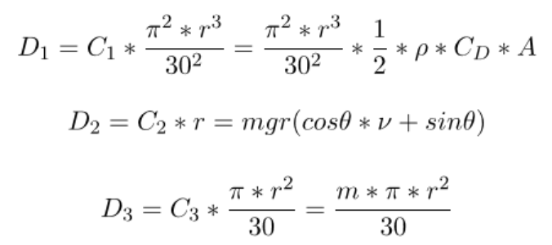
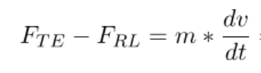
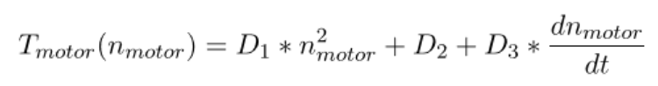
Torque Setpoint Generation Algorithm
Notes:
Even if you control the speed controlled drive, the measurements from this drive needed to go to the torque controlled drive after one communication cycle. The torque algorithm that is being is used presented in this slide. As you can see the starting point is very simple Force that is related to resistive loads is substracted from the traction force which is equal to mass times acceleration. Afterwards
Tractive force is equal to sum of rolling resistance, aerodynamic resistance, climbing resistance and acceleration related term.
After some simple mathematical operations the torque that needs to be applied by the brake drive is only dependent on the angular speed and angular acceleration where D1, D2 and D3 are dynamic road coefficients.
Torque modeling is done as I explained now in the software the measured rotational speed values needs to be fed into this algorithm and control the torque controlled drive.

Slide 8
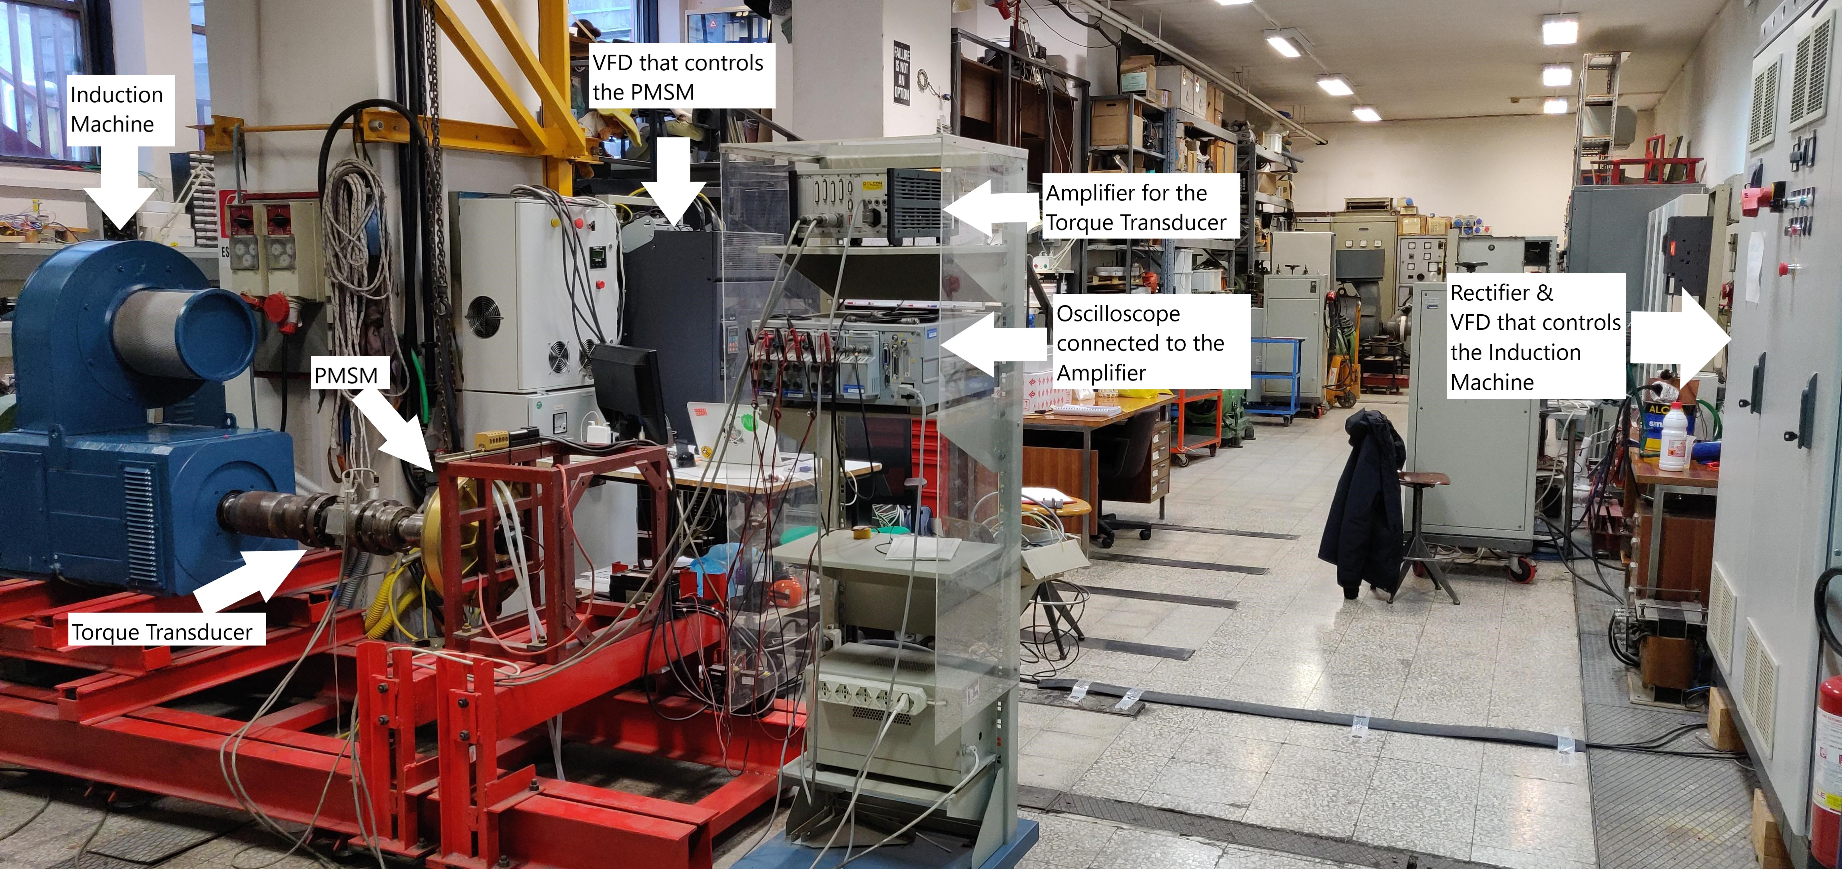
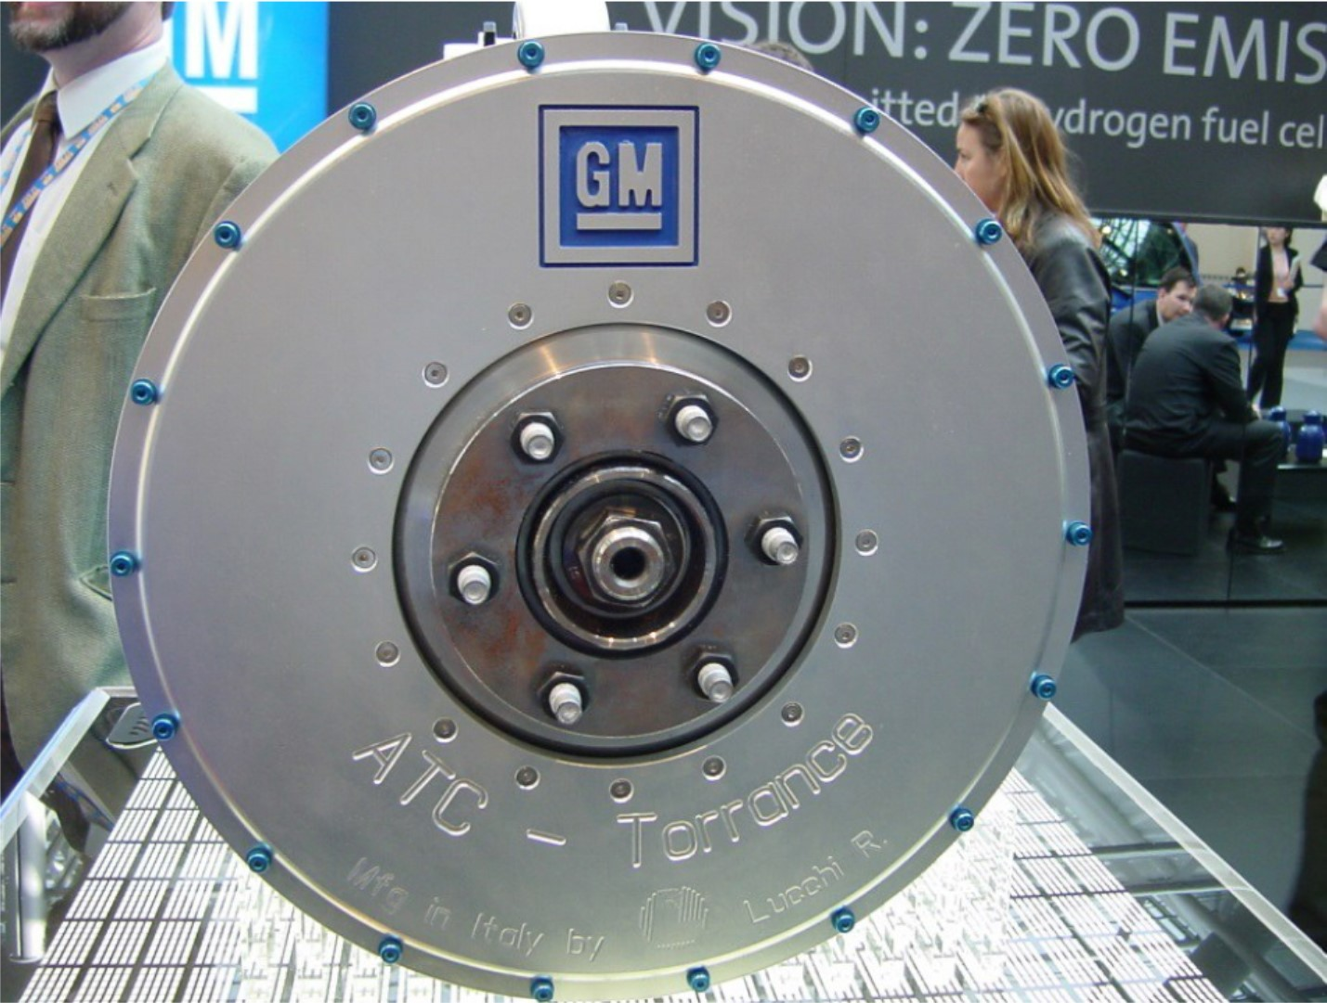
Experimental Setup
Notes:
The experimental setup consists of an induction machine and the permanent magnet syncronous machine which connected by a shaft and a torque transducer.
There are two Variable Frequency drives which control the electric motors. The torque meter is connected to an amplifier where it is connected to an oscilloscope. You can see the permanent magnet syncronous machine left bottom of the slide since the angle of the picture doesn’t show the PMSM machine properly.

Slide 9
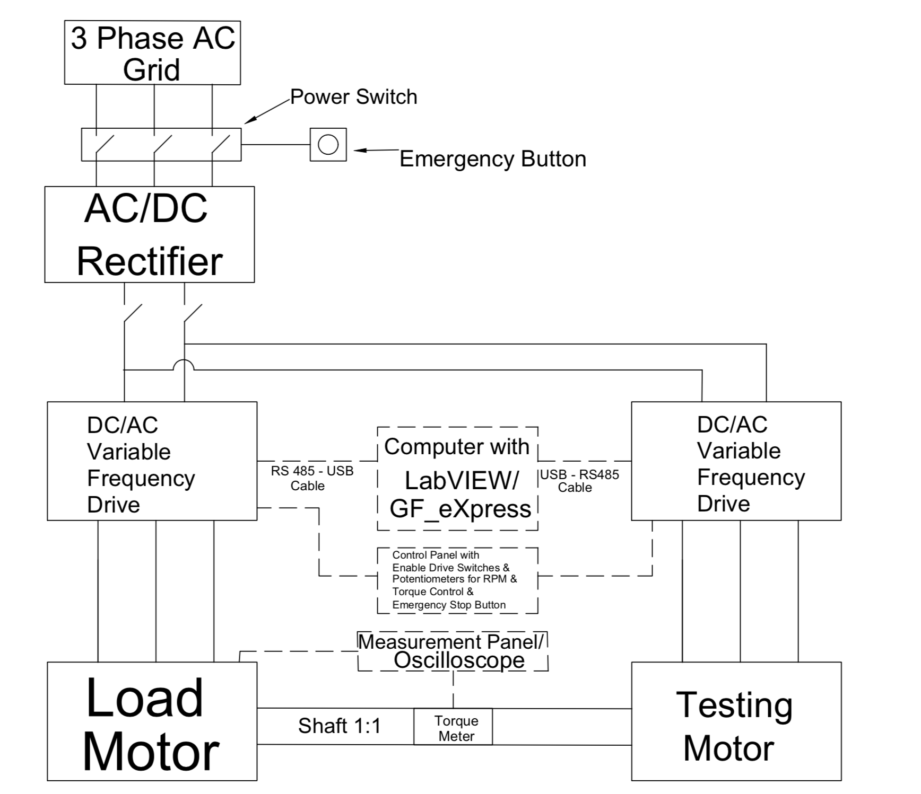
Overview of the Whole System
Notes:
In this diagram electrical power flow and serial communication can be visualized better. 3 phase AC is rectified and both of the VFD’s share a common DC bus. A computer is connected to the VFD’s by RS485-USB serial communication. Torque meter readings can be visualized with the oscilloscope. A control panel is being made to do manually controlled simple tests without having the need to use Labview or GF_eXpress which is the proprietary software of the VFD producers.

Slide 10
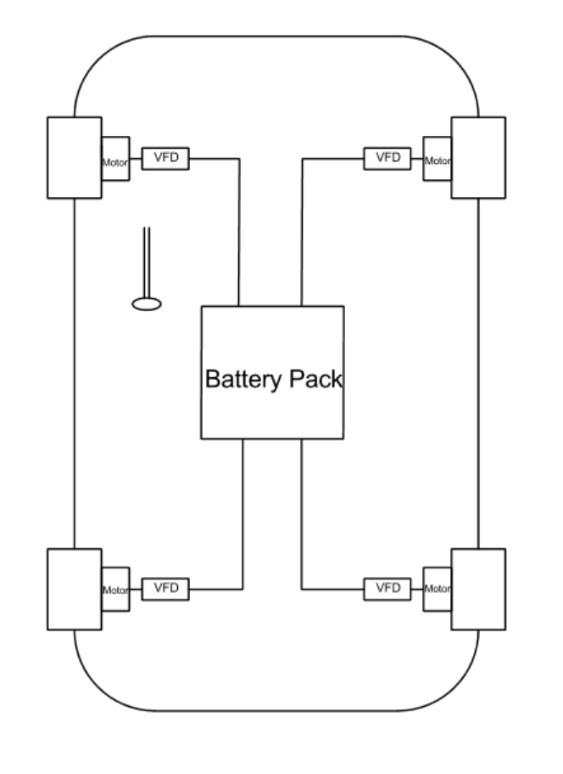
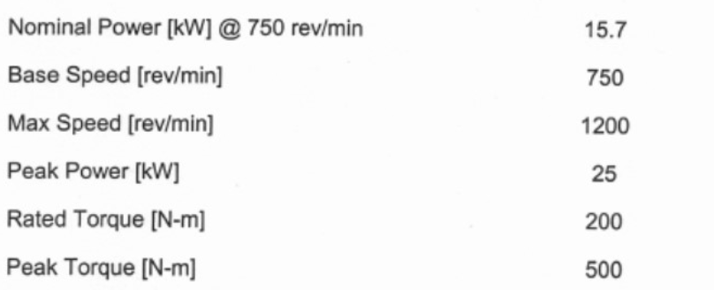
Vehicle Motor Configuration
In wheel motor
Nominal Power of 15.7kW
Precise electronic control is needed for this type of configuration
Dividing the load of the tractive system in to 4
Notes:
Vehicles that are considered to be tested are selected to have in wheel motors since the electric motor that is mounted in the test bench is a in wheel motor. In the experiments it is assumed that the load of the vehicle is distributed equally over each tyre by %25 percent which is far from reality but this assumption is made for the sake of simplification.
This type of All wheel drives uses one drive motor per wheel allowing braking or acceleration torque to each wheel to be controlled independently. This system can replace ABS, ESP making the vehicle more agile, responsive if tuned and programmed properly.

Slide 11
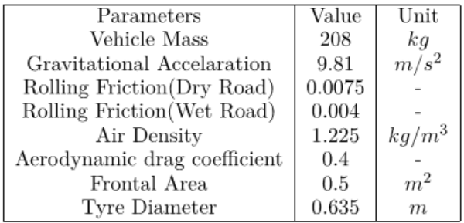
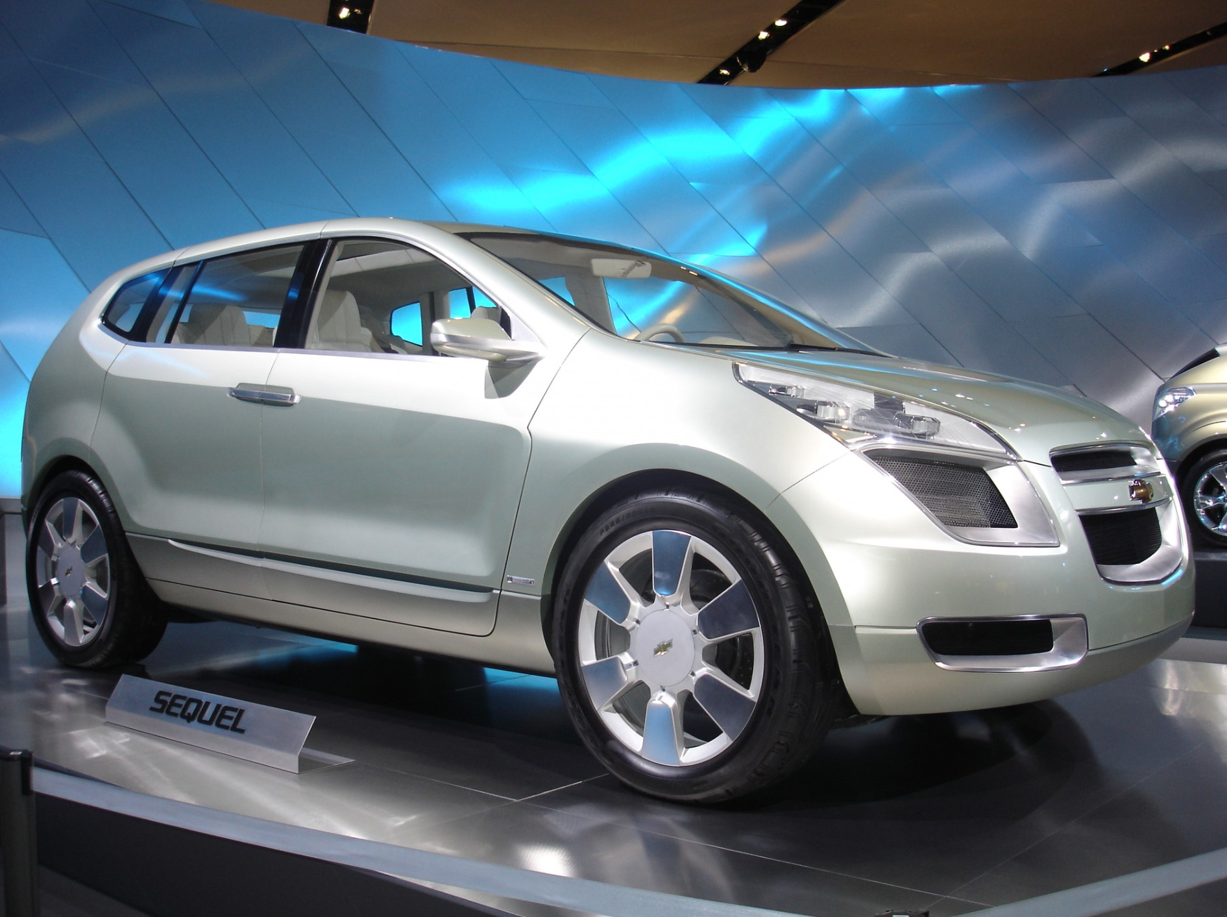
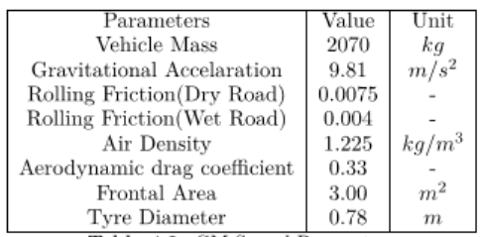
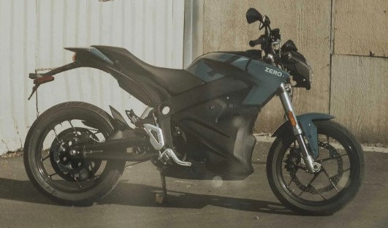
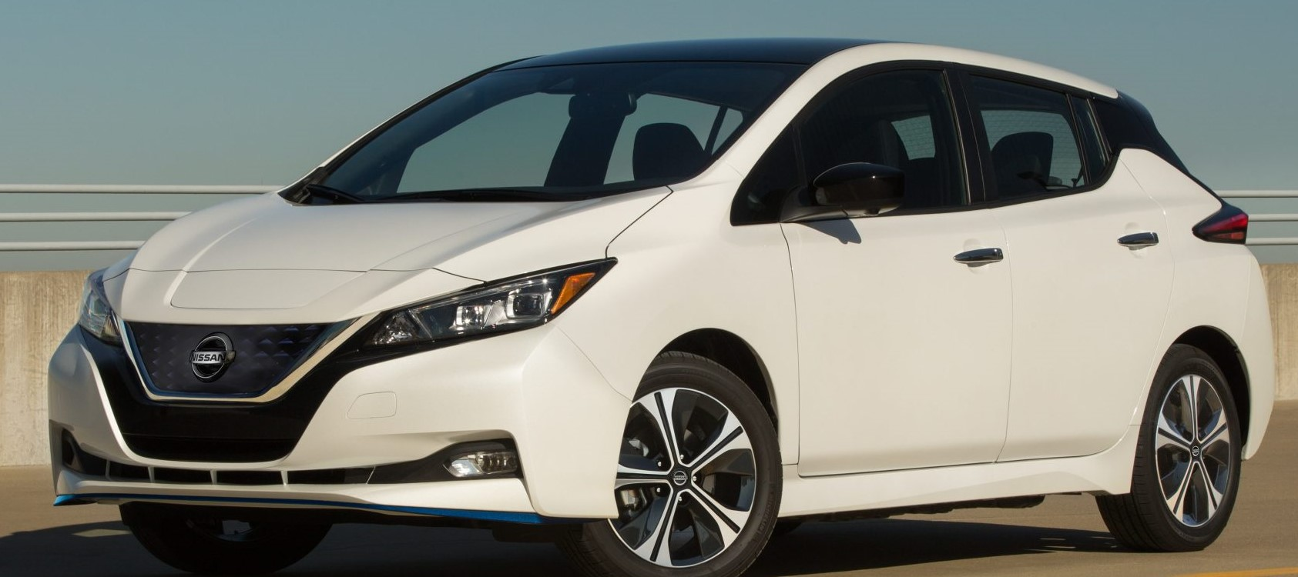
Vehicle Configurations
GM Sequel
Nissan Leaf
Zero S
Notes:
Given the fact that this motor has a nominal power of 15.7kW and maximum power of 25kW configurations that should resemble real life examples are chosen.
GM Sequel is selected since the permanent magnet synchronous machine is designed for this vehicle. This vehicle originally is a fuel cell vehicle with 2 in wheel motors on the front axle rather then 4 inwheel motors.
Nissan Leaf is selected because it is one of the most sold electric vehicle in the history.
Last configuration that is being considered is the performance type motorcycle which is made by Zero motorcycles in united states, model zero S.

Slide 12
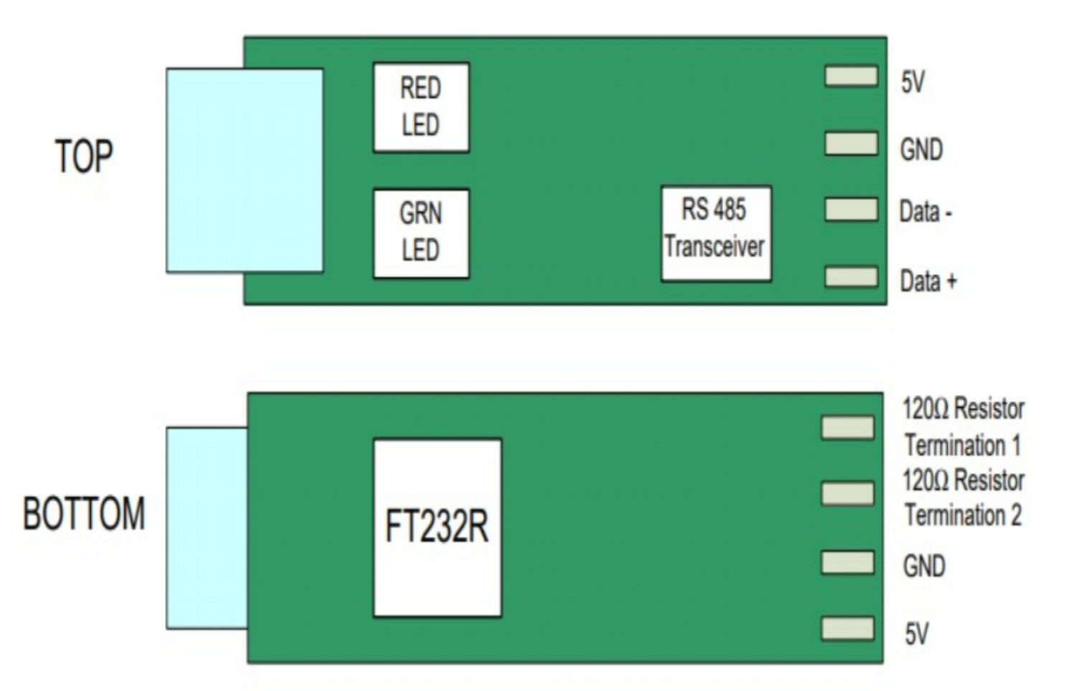
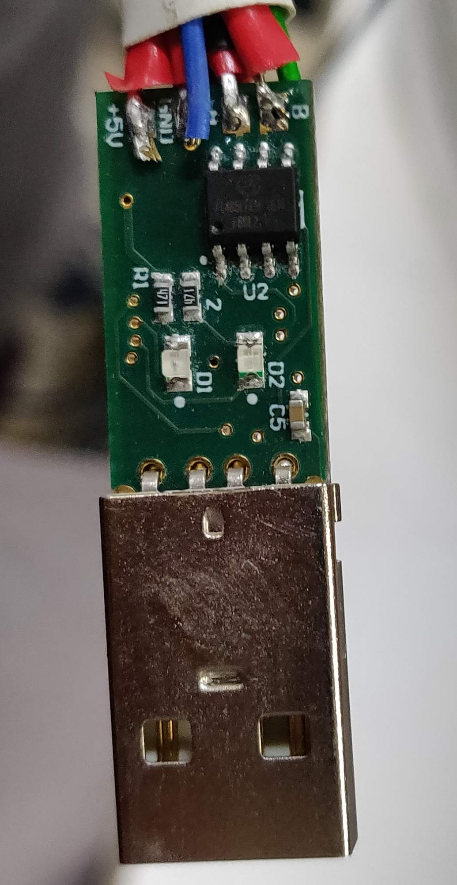
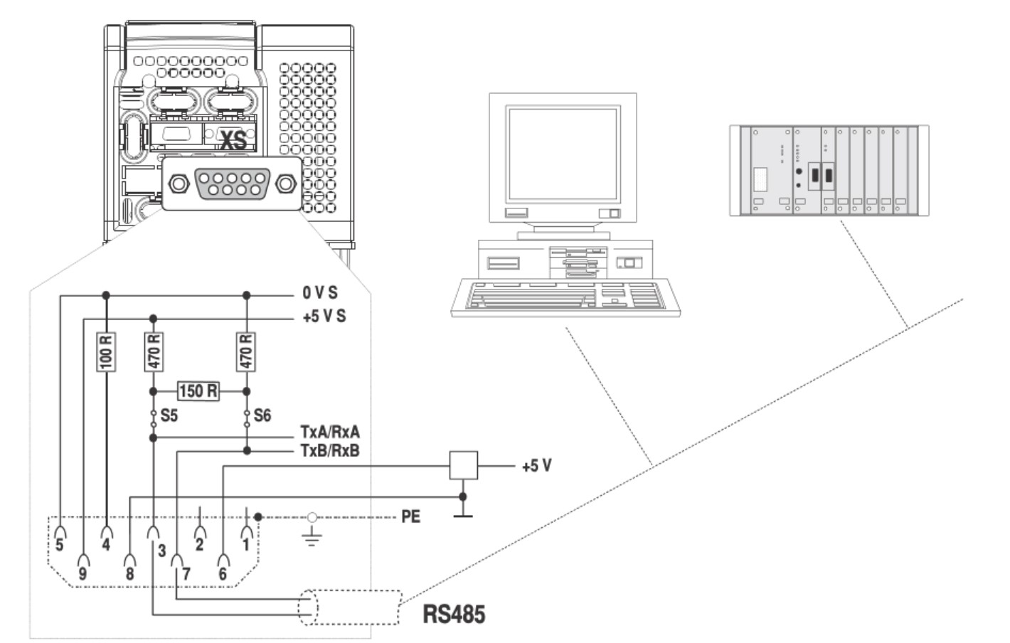
Serial Communication with RS485
Half duplex requirement
Connections are made
3xRS485 and 1xRS232 cable is tested
Notes:
In order to connect to the drives RS485-USB adapter is used. In modbus protocol it is advised that half-duplex type of connection should be used. The connections are soldered according to the VFD manual and the manual of the RS485 adapter. During the process of connection to the drives
3 other different cables are tested which took over a month to make the right connections and shielding which was not that clear in any manual. Also RS-232 adapter is used in the beginning of the development of the system.

Slide 13
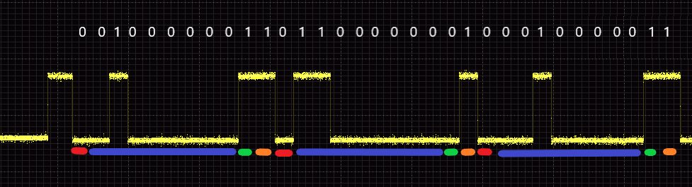
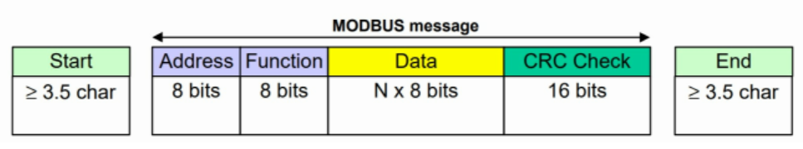
Signal Interception and Deciphering to use Modbus-RTU
The format (11 bits ) for each byte in RTU mode is:
Coding system: 8 bit binary
Bits per Byte: 1 start bit
8 data bits, least significant bit sent first
1 bit for parity completion
1 stop bit
Address
Function
Data
CRC Check
Notes:
In the first 2 months of the research a stable connection between the drives can not be done. By intercepting the serial line with a simple adapter, the signals that are sent by the proprietary software is
Decoded and eventually helped me to understand the framing. Where there are 11 bits for each byte and internally divided in to 1 start, 8 data, 1 parity, 1 stop bit. From the oscilloscope image you can see the recurrance of the different parts of an 11 bit package.
In MODBUS Serial Line, the Address ﬁeld only contains the slave address.
The function code indicates to the server what kind of action to perform.
The function code can be followed by a data ﬁeld that contains request and
response parameters.
Error checking ﬁeld is the result of a "Redundancy Checking" calculation that is
performed on the message contents.
The CRC ﬁeld is appended to the message as the last ﬁeld in the message.
After learning the protocol the phase to create a software came.

Slide 14
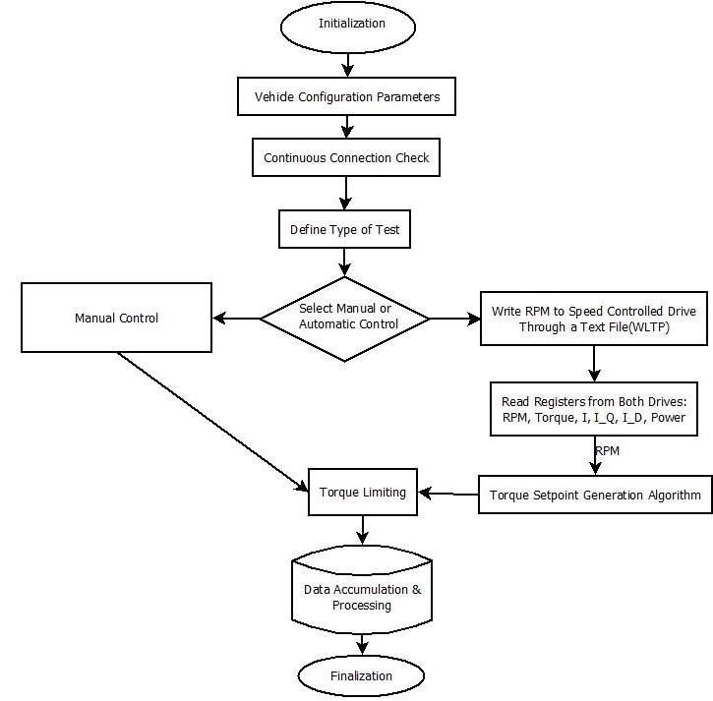
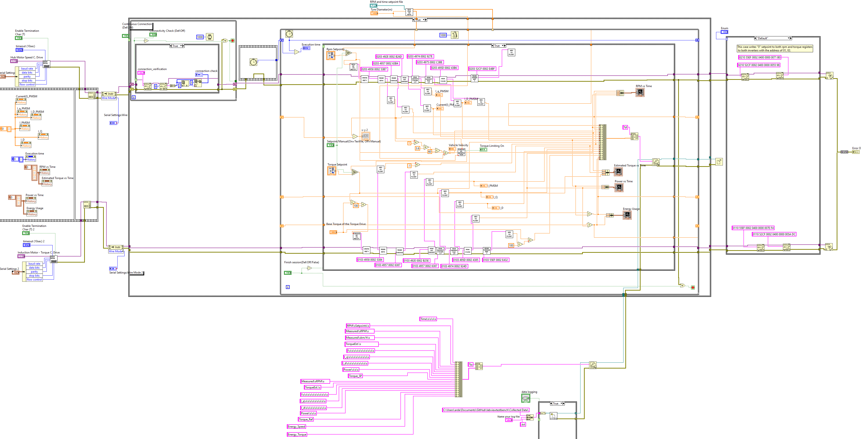


Data Flow Chart of the LabVIEW Software
Initialization
Vehicle Configuration
Continuous Connection Check
Automatic or Manual Test Choice
Data Accumulation
Finalization
Notes:
In the initialization part, before starting any test, the responsible must conﬁgure the serial settings of the variable frequency converters.
Correct communication ports needs to be selected. The correct text file that we want to input also needs to be prepared to a certain format and selected.
Continuous Connection Check: The connectivity between the inverter and LabVIEW is checked, stable connection is verified by checking if the answer from the drive is expected or not.
There are two possible test configurations that can be utilized in this LabVIEW software. One is automatic testing mode and the latter is manual testing mode.

Slide 15
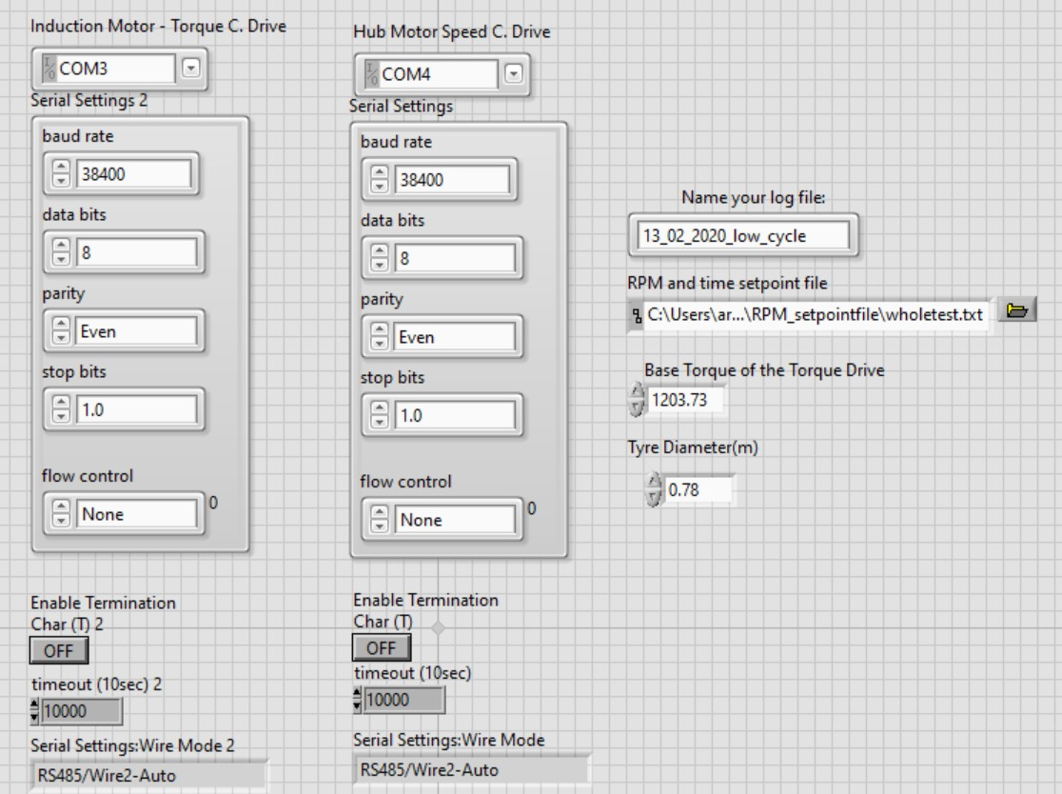
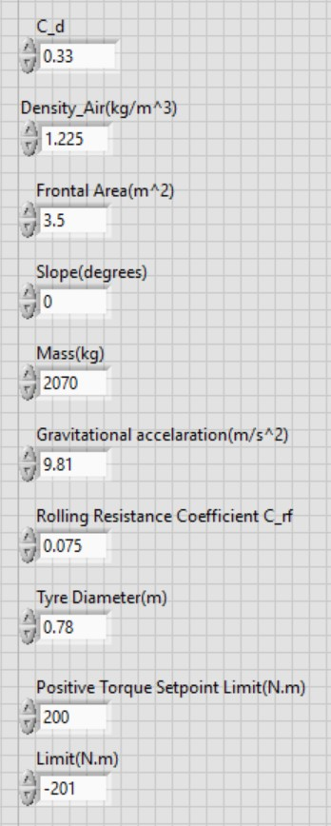
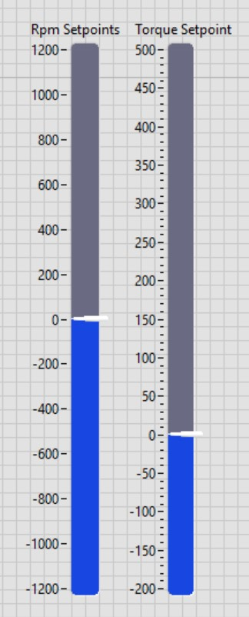
Software User Interface
Automatic
Manual Mode
Text file with a certain format
Vehicle parameters
Two sliders for speed and torque
Vehicle parameters
Notes:
In automatic mode of a text file needs to be chosen with LabVIEW which has to have a certain format in order to read the kilometer per hour setpoints for the RPM controlled drive. Corresponding vehicle parameters needs to be inputted for both of the modes of the operation.
Manual operation is very simple there are two sliders which can change the real time torque and rpm of the motors. The data that is being read from the drive registers are stored in a text file.

Slide 16
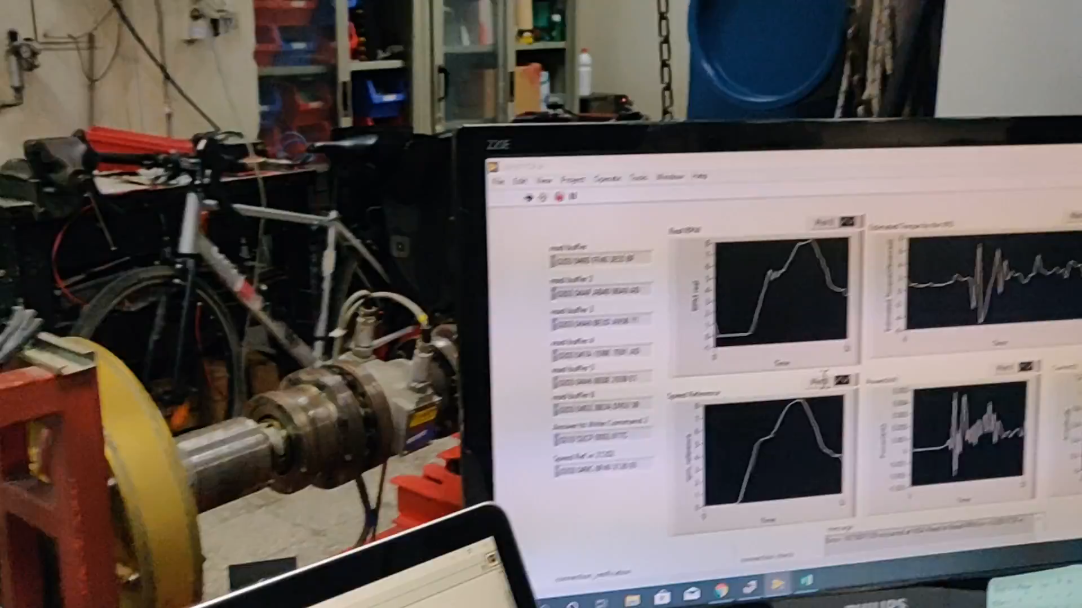
Notes:
A video from the first day of operation of the

Slide 17
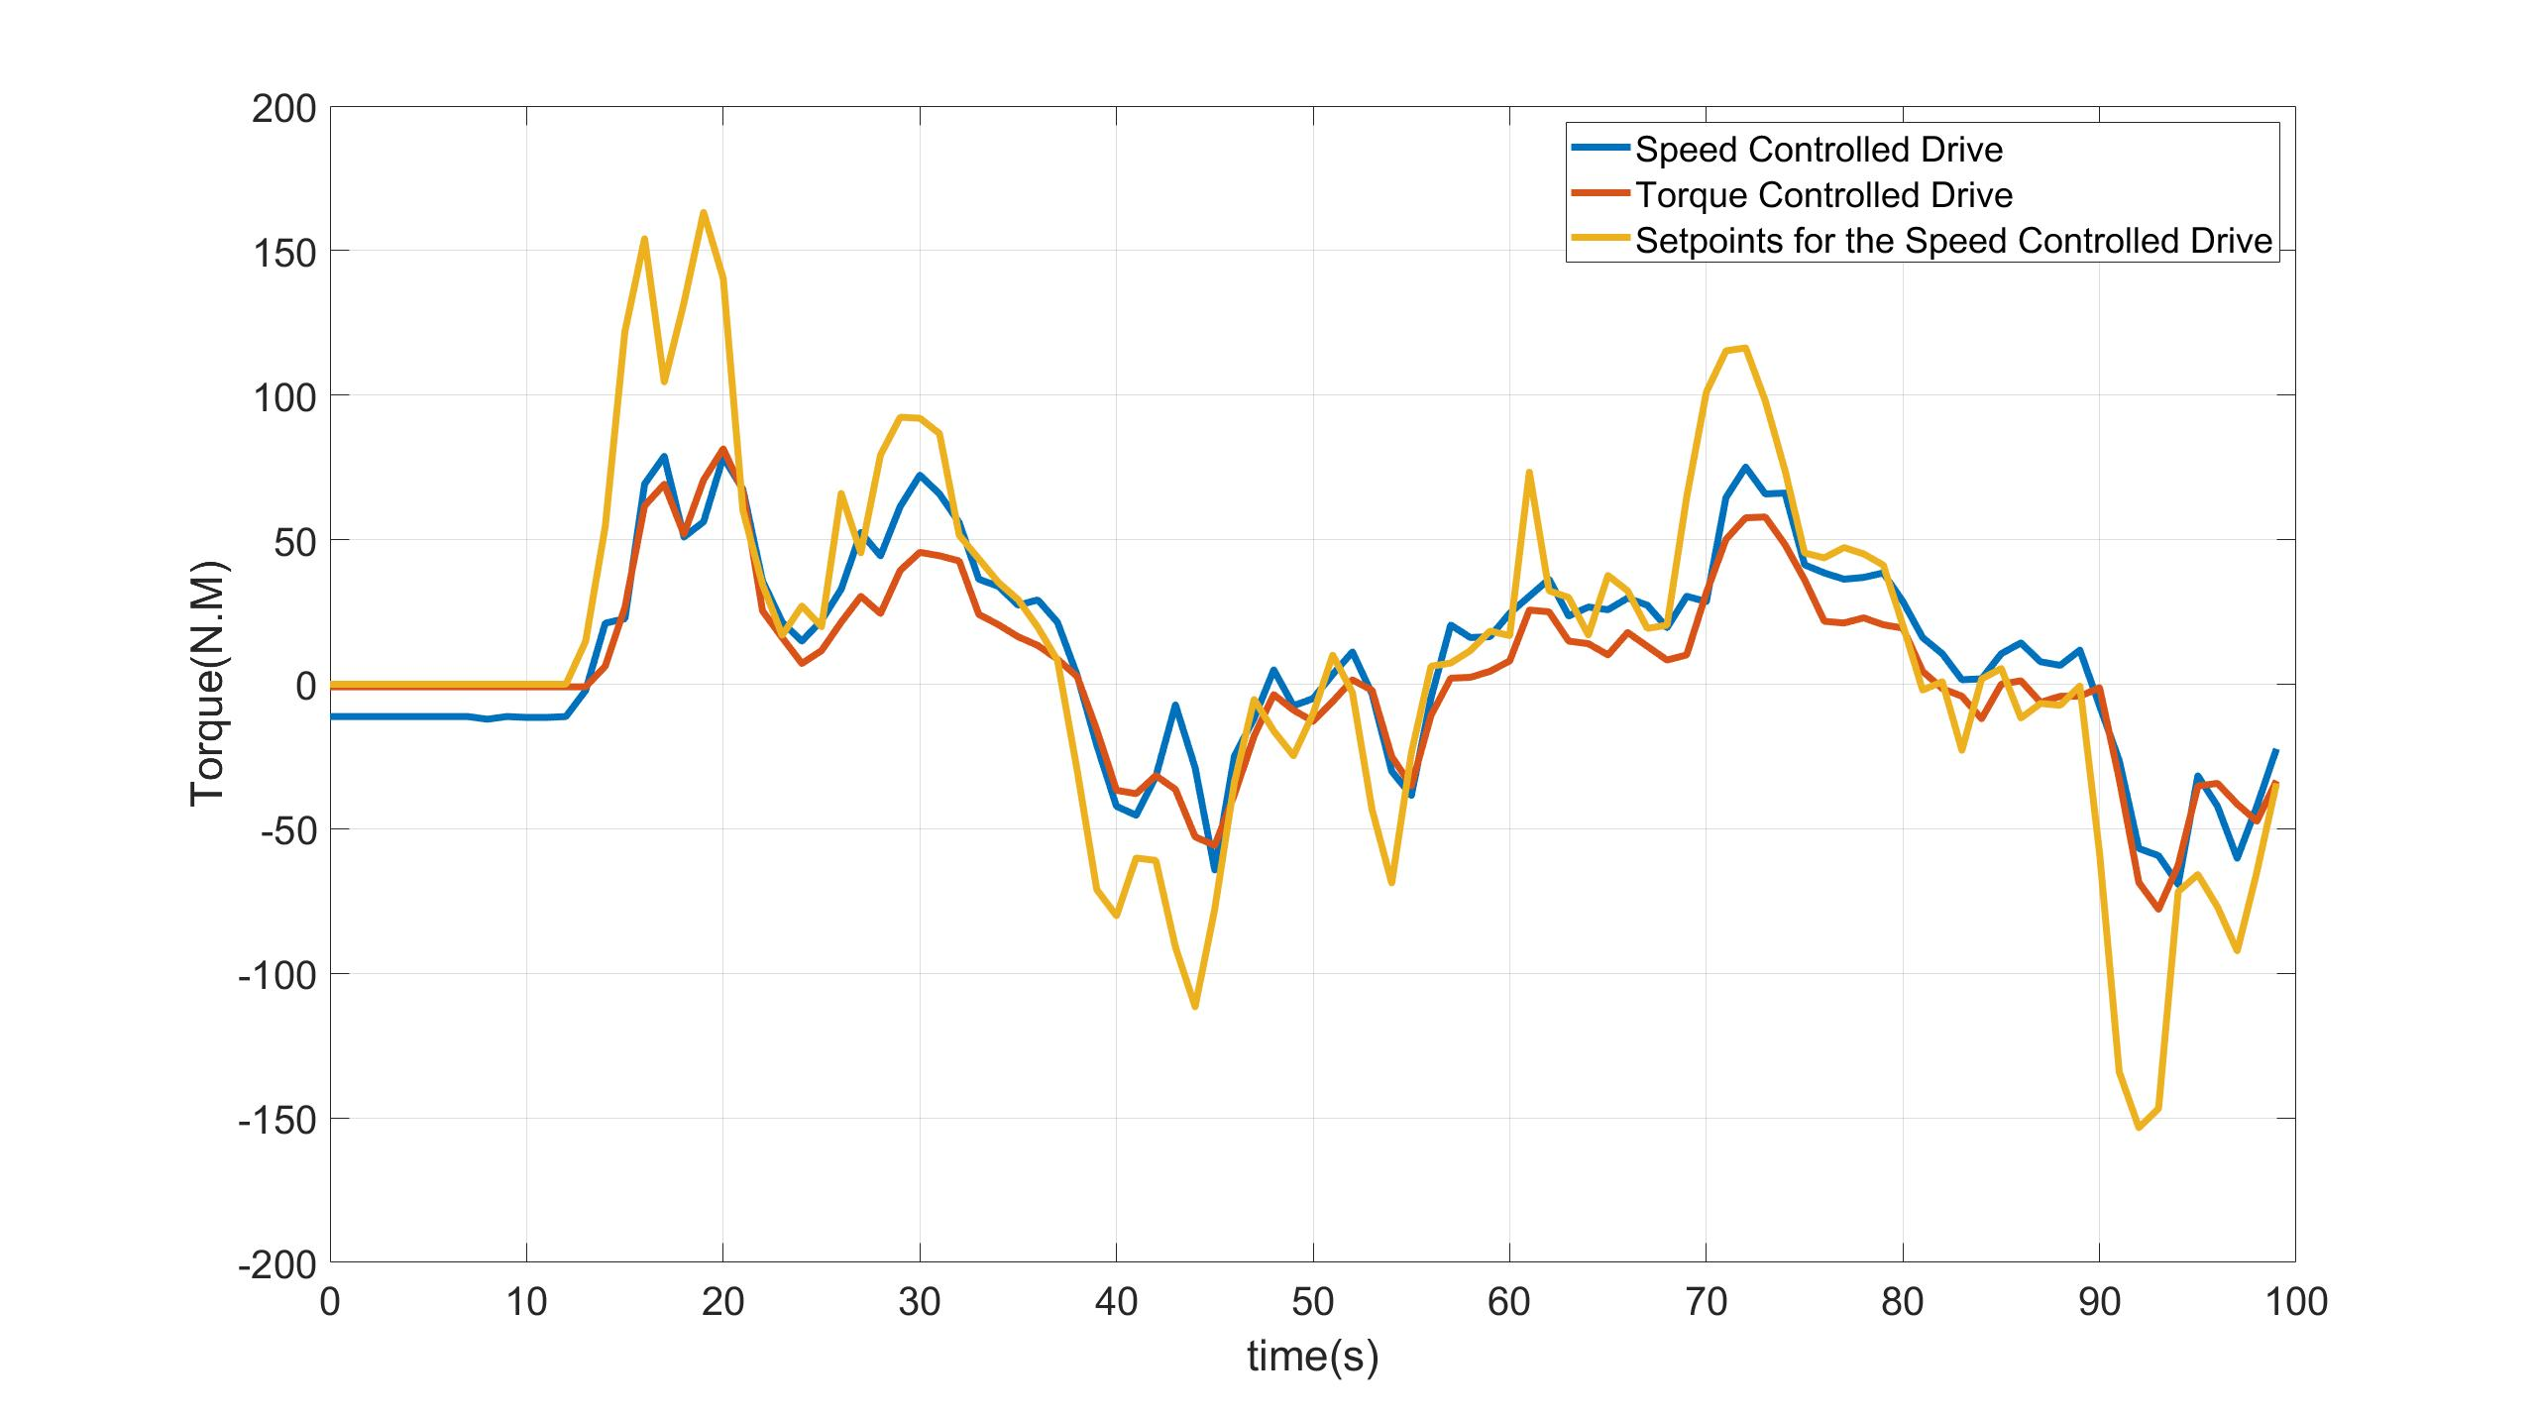
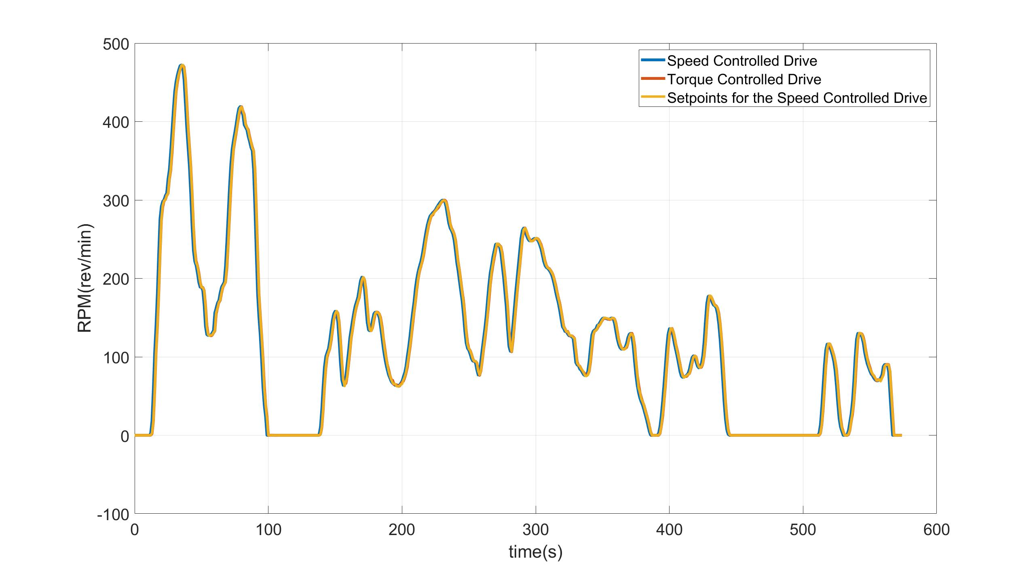
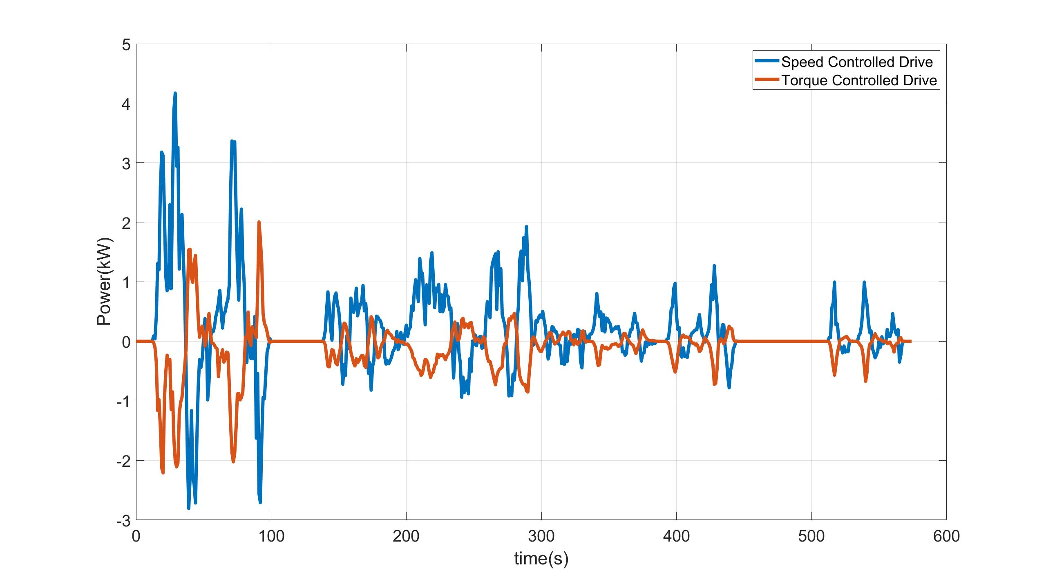
Results – Low Cycle
Notes:
This test is done with the parameters of GM-Sequel which is presented previously in my presentaton.
As can be seen

Slide 18
Conclusions & Limitations
Torque setpoints and readings are flawed
High, Very-High sections of WLTP can not be conducted
Semi manual mode is not allowed, only controlling the speed drive and making the algorithm generate the torque values
Frequency of sampling 1Hz needs to be improved for power and current readings
Notes:
The estimated torque readings from the VFD registers have %10-%20 offset when compared with the torque meter values.
Since the maximum speed of the PMSM motor is 1200rpm and in high, very-high sections of wltp the drive needed to go up to 1700 rpm the 3rd and 4th part of the WLTP can not be conducted.
Semi manual mode is not allowed where changing the RPM manually and
Frequency of sampling is 1Hz which definitely needs to be improved

Slide 19
Future Work
Torque meter readings implementation to LabVIEW via RS232
Features migration from the proprietary software
CAN protocol
Increase of the frequency of serial communication >1Hz
Acceleration Pedal Implementation
Notes:
Torque meter readings could be implemented to Labview software for better estimation of power and energy consumption with an RS232 connector. If this can be done, the measurements would

Slide 20
References
https://www.wltpfacts.eu/
ANTON RASSOLKIN. "Research and Development of Trial Instrumentation for Electric Propulsion Motor Drives". PhD thesis. Tallinn University of Technology, 2014.

Slide 21


